Slide 1
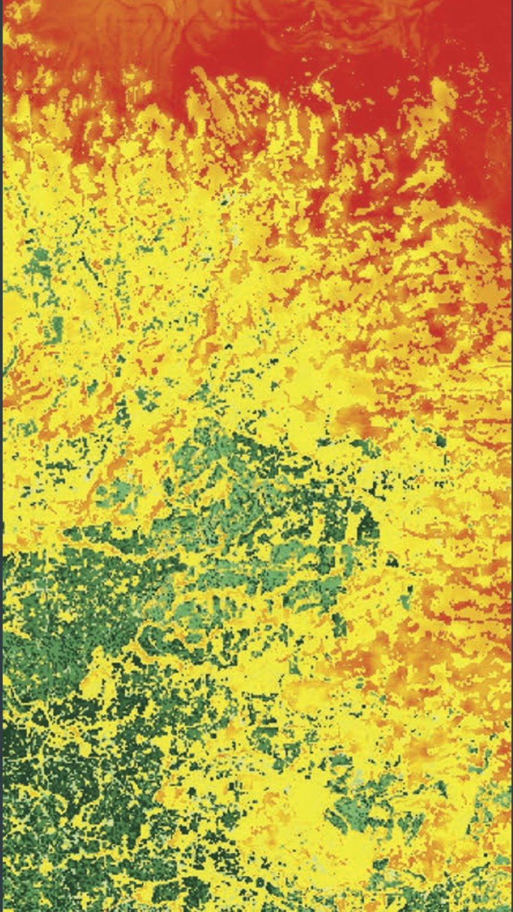
Wildfire
Risk Model
MM.DD.YY
Yutong Jiang, Jingmiao Fei

Slide 2
Contents
1.
Why Wildfire?
2.
Target Users
3.
Data & Model
4.
Results
5.
Future Approach

Slide 3
Why Wildfire?
Wildland‑Urban Interface increases (WUI):
The expansion of the WUI is driven by rapid urbanization, which increasingly pushes residential development into fire-prone wildland areas.

Slide 4
Why Wildfire?
Rising heat & drought lengthen fire seasons everywhere:
Rising temperatures and prolonged drought conditions, intensified by global climate change, are extending the duration and severity of wildfire seasons worldwide.

Slide 5
Study Area
Agola
High wildfire frequency in Miombo woodland and savanna regions
Vulnerable ecosystems with biodiversity at risk
Limited local fire monitoring systems and predictive modeling
Growing land-use pressures from agriculture, deforestation, and population expansion

Slide 6
Target User
Urban planners shaping rapidly growing cities
Developers expanding into peri-urban or wildland areas
Operating in contexts with limited geospatial or climate data
Need accessible tools for climate-informed planning

Slide 7
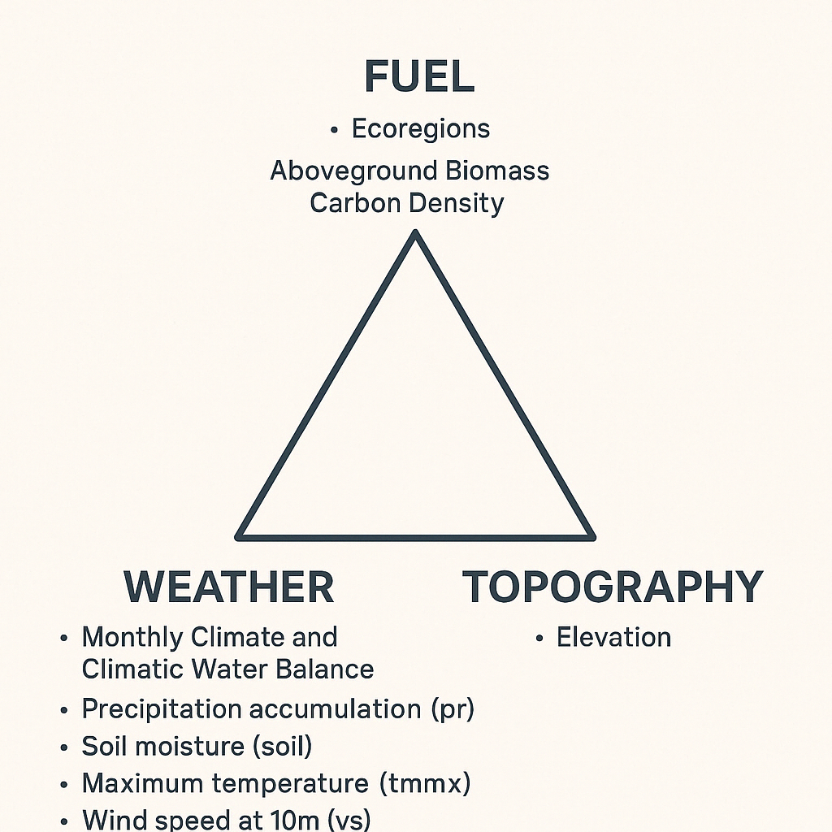

Data Selection
NDVI
Aboveground BiomassCarbon Density
Random
Forest

Slide 8
Data & Model
Data Collection
Preprocessing
Modeling
Performance
Drought Severity Index
Soil Moisture
Precipitation Accumulation
Wind Speed
Maximum Temperature
NDVI
Elevation
Biomass Carbon Density
Population
Burnt Area Monthly
Eco-regions (Angola)
Clip
- Spatial: study area
- Temporal: calculate
dry season
(2020.6 - 2020.8)
Random Forest
- predict probability
X
Accuracy
Confusion Matrix
Feature Importance
Binarize
- 0 (not burnt)
- 1 (burnt)
Sample Size
1500
1500
Train-test split: 7:3
Y
Study
Area
Data Source: GEE

Slide 9
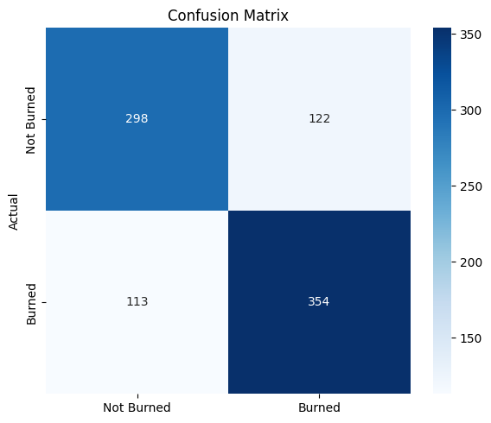
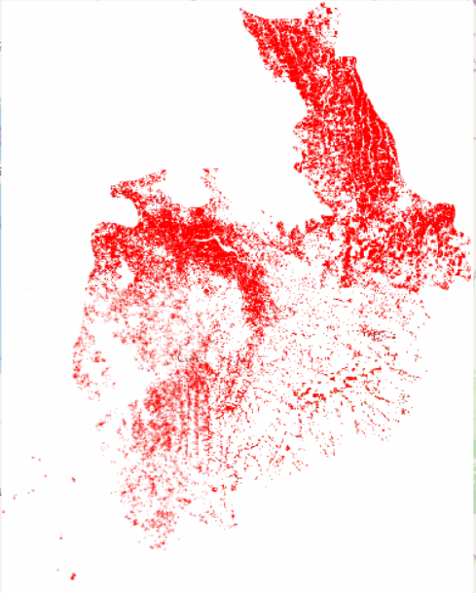
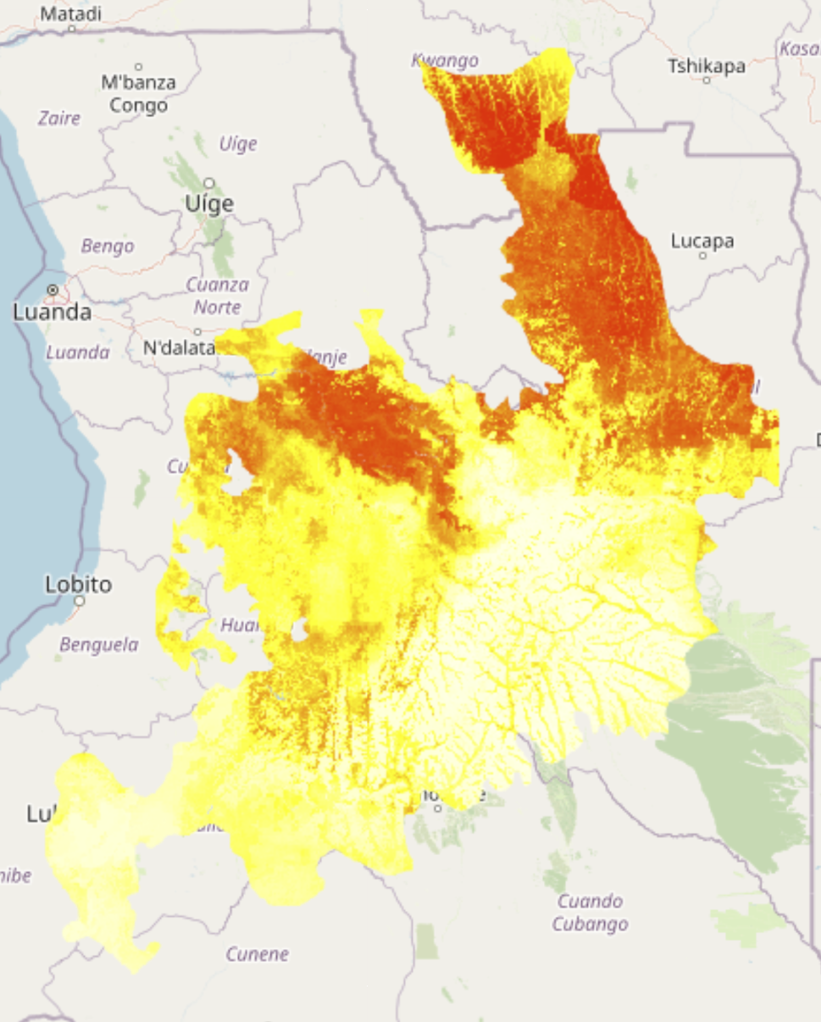

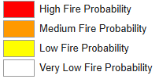
Result
Ground Truth
Prediction
Overall Accuracy = 73.5%
Notes:
comparing the prediction and the ground truth, we can see that the areas predicted with high or medium fire probability overlap well with the actual burned areas.

Slide 10
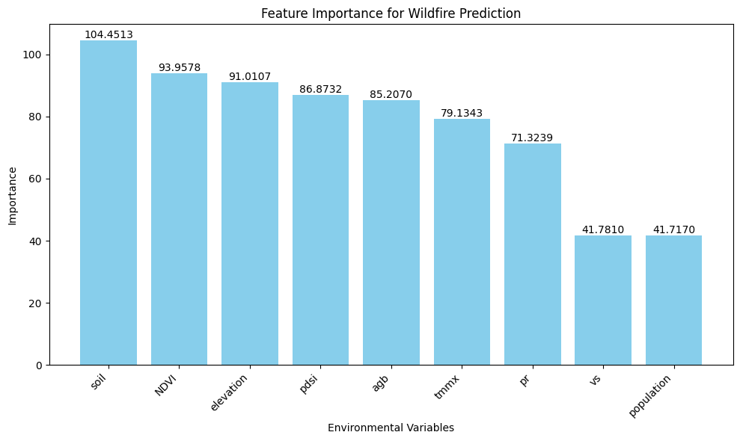
Result
Feature Importance Top3: Soil Moisture, NDVI, DEM

Slide 11
Future Approach
Spatiotemporal generalization test
– accuracy on data from other time periods or regions
Hyperparameter tuning
Feature selection based on feature importance rank

